Slide 1
Chapter 6: Test Management
Software Testing
Lecture 27
Test Estimates

Slide 2
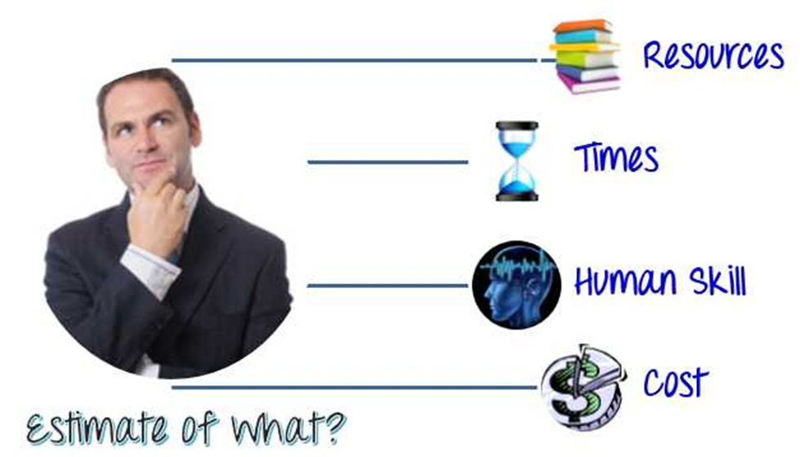
Why Test Estimation?
How long will this testing take?
How much will it cost?
What to Estimate?

Slide 3
What to Estimate?
Resources: Resources are required to carry out any project tasks. They can be people, equipment, facilities, funding, or anything else capable of definition required for the completion of a project activity.
Times : Time is the most valuable resource in a project. Every project has a deadline to delivery.
Human Skills : Human skills mean the knowledge and the experience of the Team members. They affect to your estimation. For example, a team, whose members have low testing skills, will take more time to finish the project than the one which has high testing skills.
Cost: Cost is the project budget. Generally speaking, it means how much money it takes to finish the project.

Slide 4
Test Estimation Techniques
There are different Software Testing Estimation Techniques which can be used for estimating a task.
Delphi Technique
Work Breakdown Structure (WBS)
Three Point Estimation
Functional Point Method

Slide 5
Delphi Technique
This is one of the widely used software testing estimation technique.
In the Delphi Method is based on surveys and basically collects the information from participants who are experts.
In this estimation technique each task is assigned to each team member & over multiple rounds surveys are conduct unless & until a final estimation of task is not finalized.
In each round the thought about task are gathered & feedback is provided. By using this method, you can get quantitative and qualitative results.
In overall techniques this technique gives good confidence in the estimation. This technique can be used with the combination of the other techniques.

Slide 6
Work Breakdown Structure (WBS)
A big project is made manageable by first breaking it down into individual components in a hierarchical structure, known as the WBS.
The WBS helps to project manager and the team to create the task scheduling, detailed cost estimation of the project.
By using the WBS motions, the project manager and team will have a pretty good idea whether or not they’ve captured all the necessary tasks, based on the project requirements, which are going to need to happen to get the job done.
In this technique the complex project is divided into smaller pieces. The modules are divided into smaller sub-modules. Each sub-modules are further divided into functionality.
And each functionality can be divided into sub-functionalities. After breakdown the work all functionality should review to check whether each & every functionality is covered in the WBS.

Slide 7
Three Point Estimation
Three point estimation is the estimation method is based on statistical data.
It is very much similar to WBS technique, task are broken down into subtasks & three types of estimation are done on this sub pieces.
Optimistic Estimate (Best case scenario in which nothing goes wrong and all conditions are optimal.) = A
Most Likely Estimate (most likely duration and there may be some problem but most of the things will go right.) = M
Pessimistic Estimate (worst case scenario which everything goes wrong.) = B
Formula to find Value for Estimate (E) = A + (4*M) + B / 6 Standard Deviation (SD) = = (B – A)/6

Slide 8
Functional Point Method
Functional Point is measured from a functional, or user, point of view.
It is independent of computer language, capability, technology or development methodology of the team.
It is based on available documents like SRS, Design etc. In this FP technique we have to give weightage to each functional point.
Prior to start actual estimating tasks functional points are divided into three groups like Complex, Medium & Simple. Based on similar projects & Organization standards we have to define estimate per function points.
Total Effort Estimate = Total Function Points * Estimate defined per Functional Point

Slide 9
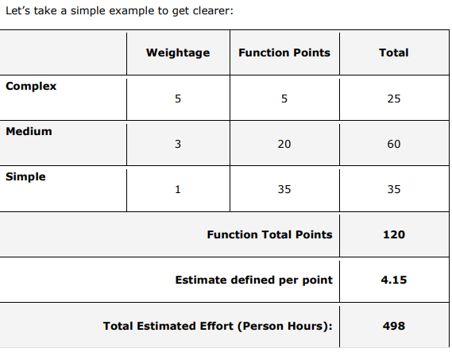
Functional Point Method

Slide 10
Disadvantages of Techniques
Due to hidden factors can be over or under estimated.
Not really accurate
It is based on thinking.
Involved Risk.
May give false result.
Bare to losing.
Sometimes cannot trust in estimate

Slide 11
Thank you

